Slide 1
Model Electrolyser
CS229 Project – H2xML

Slide 2
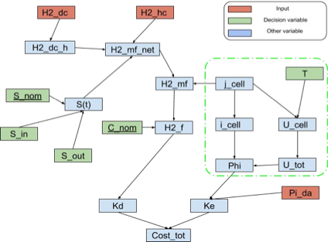
Presentation

Slide 3
Parameters , inputs and inputs of the model
Parameters
Electrolyser nominal power
Cell area
Technology (PEM, Alkaline, SOFC)
Output H2 pressure
Inputs
H2 rate of production [kg/s]
Temperature
Outputs
Input power
Degradation (?)

Slide 4
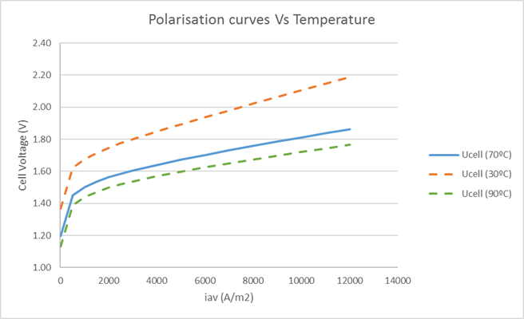
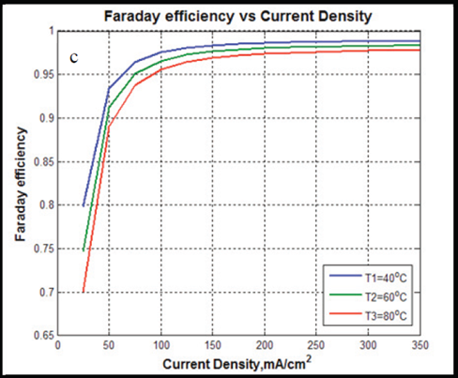
Modelling
I-V curve fitting: Current through cell -> Cell voltage
Thermoneutral voltage: Cell voltage -> thermal power required
ΔH_{t,P} = nFV^{tn}_{t,P}
Stack & Faradaic efficiency: thermal power -> Electric power

Slide 5
References

